Slide 1
TCS World 10K Bengaluru
Your NGO logo here
NGO Orientation Presentation
Race Day: 28th April 2024
tcsw10k.aidbees.org

Slide 2
2023 Edition- TCS World 10K
Bengaluru has been a proud host of the World’s Premier 10K Run – the TCS World 10K Bengaluru - since 2008. The event has had the distinction of having some of the fastest international and Indian runners competing for the coveted podium finish, and mass participation of thousands of runners from across the country and world, all soaking in the Bengaluru energy and camaraderie. The year 2023 was aidbees first year with the event. Below are the highlights of the run.
Rs. 2.7 crores+
Total funds raised
27,000+
Footfall in 2023
80+
participating NGOs
29
Participating Corporates
65+
Individual Fundraisers
tcsw10k.aidbees.org

Slide 3
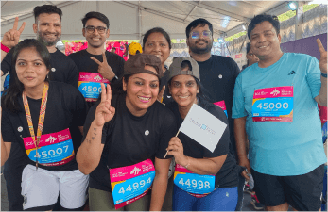
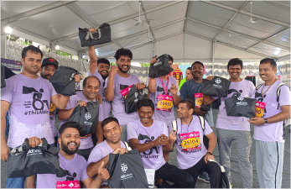
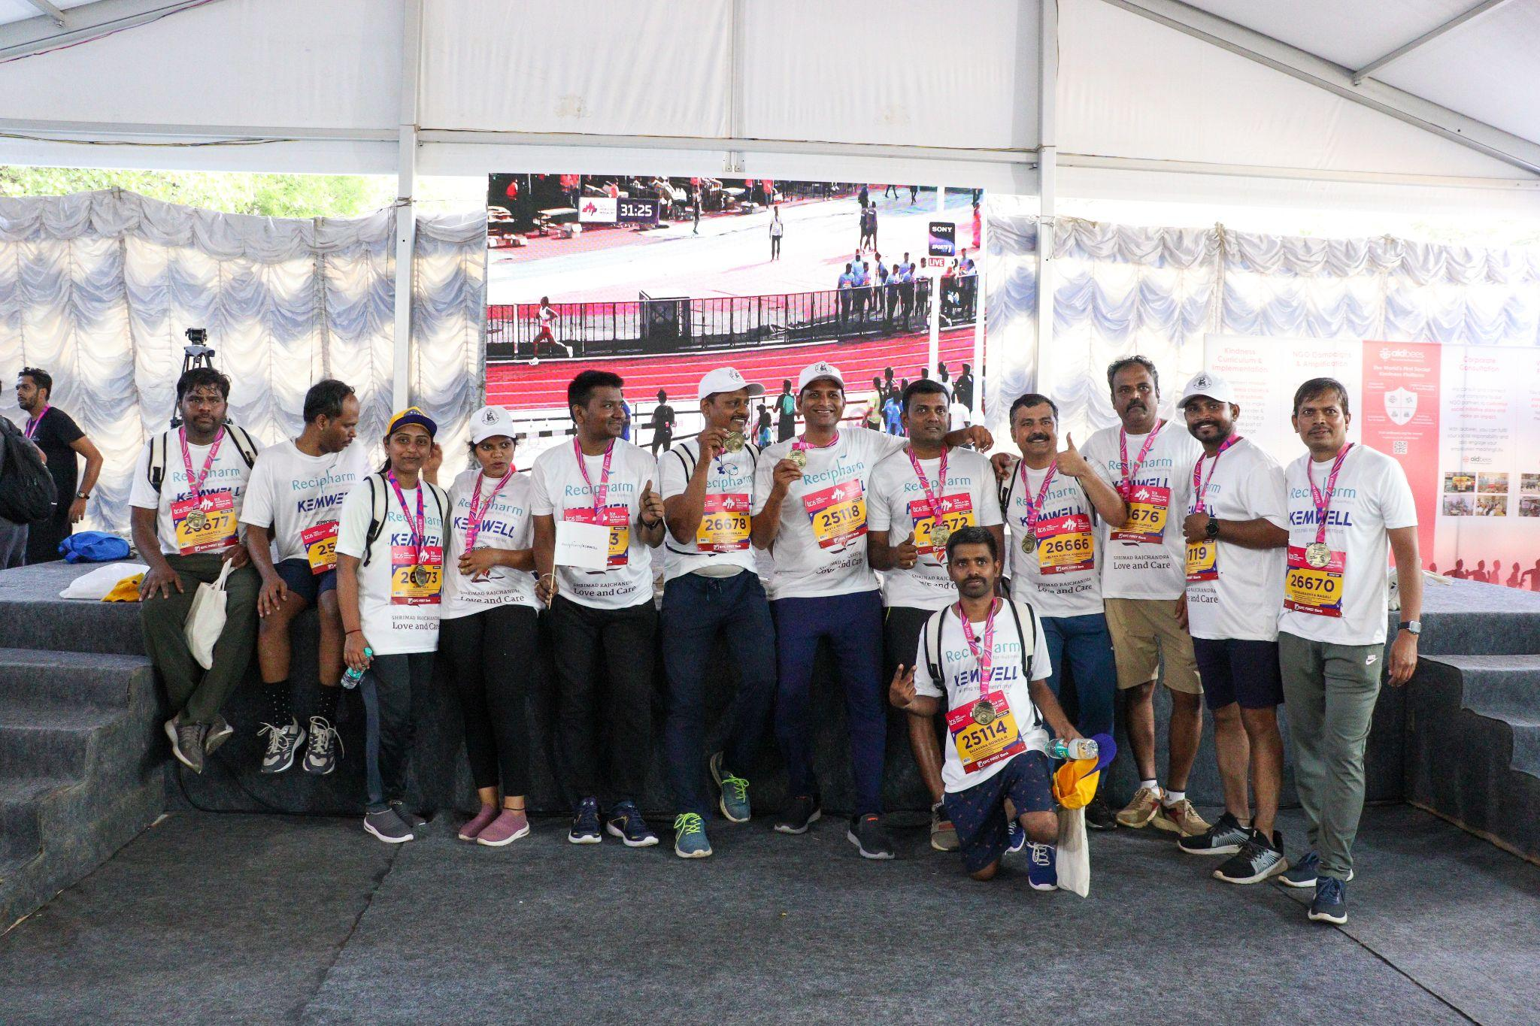
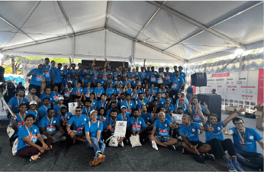
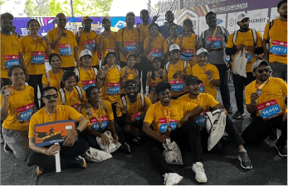
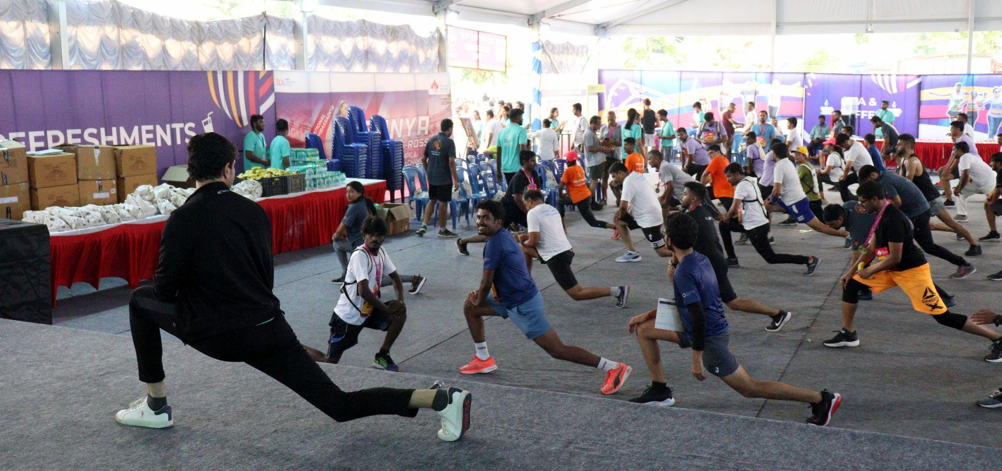
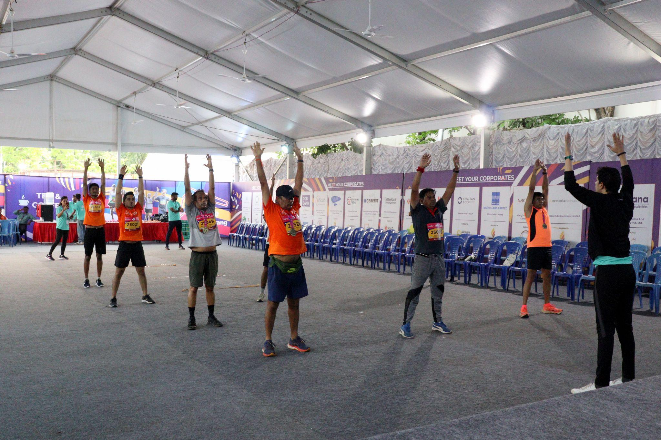
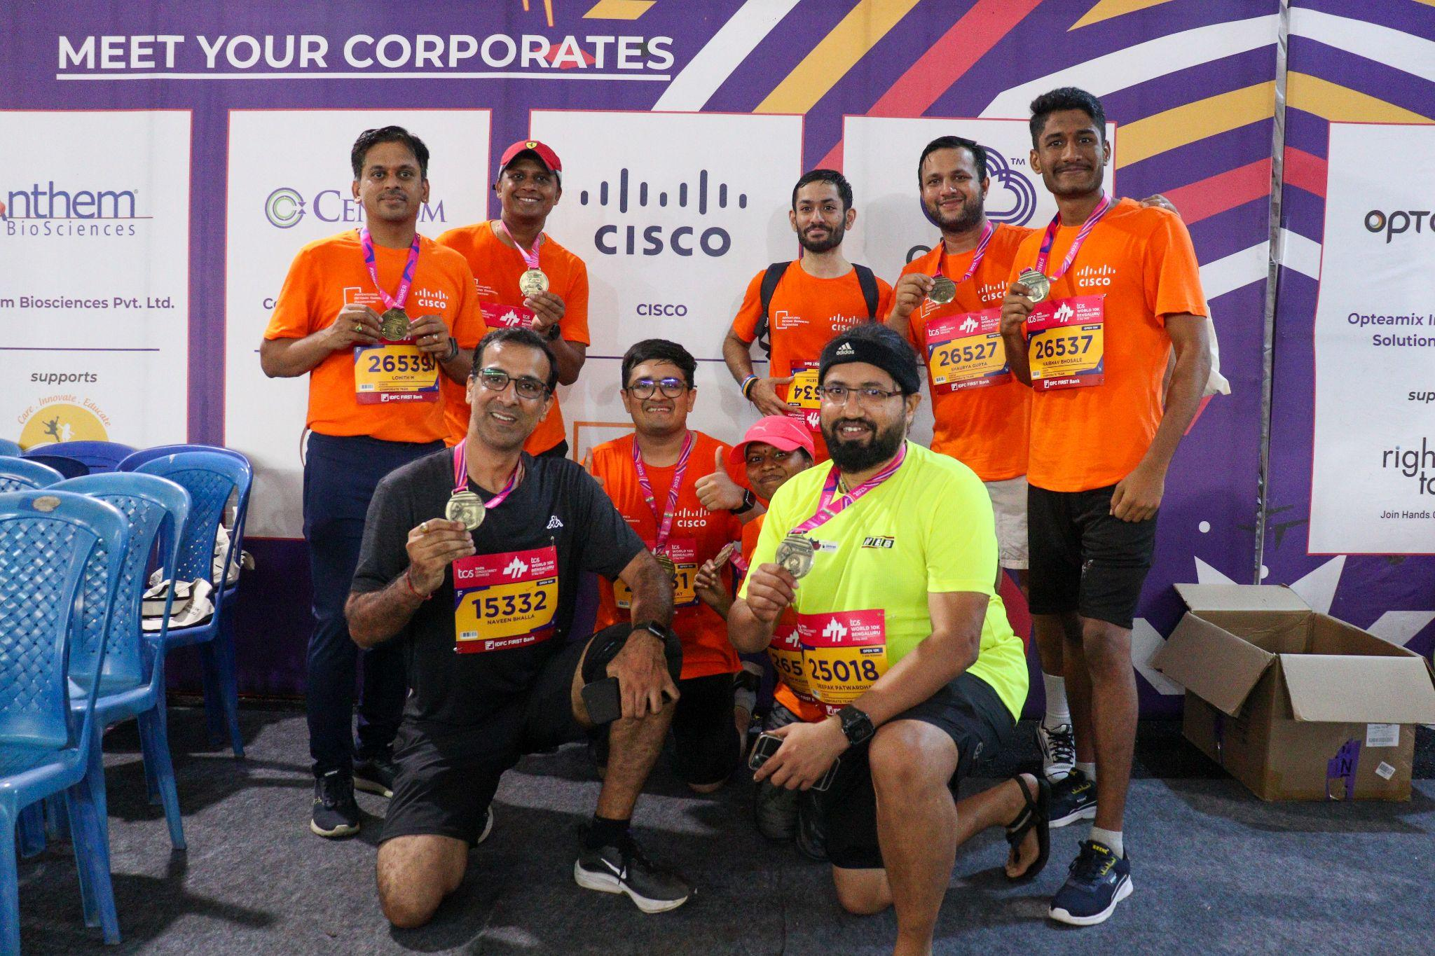
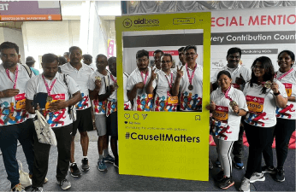
2023 Highlights from Corporate Tent
tcsw10k.aidbees.org

Slide 4
About Us (NGO details)
tcsw10k.aidbees.org

Slide 5
NGO History
tcsw10k.aidbees.org

Slide 6
Projects and Impact
tcsw10k.aidbees.org

Slide 7
What do we expect?
tcsw10k.aidbees.org

Slide 8
What’s in it for you?
Create a socially conscious environment by engaging your employees in philanthropy and fundraising for a social cause
Branding and Visibility Opportunities through Race routes (Tshirts, badges, race collaterals)
Massive opportunity for team building activity. The bigger the contingent the bigger the visibility.
Help an NGO in their efforts to make a difference through fundraising and pledge based recurring donations.
tcsw10k.aidbees.org

Slide 9
Contact Us
tcsw10k.aidbees.org
<your name>
<Your number> | <Your email ID>
tcsw10k.aidbees.org

Slide 10
Thank You!
tcsw10k.aidbees.org

